Slide 1

┌
NOMAO Challenge
┌
- What data refer to the same place?
Lingdi Huang

Slide 2
Overview of Presentation
1
Introduction
2
Data Description
3
Model Selection
4
Feature importance & Conclusion

Slide 3

Introduction
“
As a place search engine, Nomao wants to detect what data refers to the same place. To automate this duplicated process, a model is built.

Slide 4
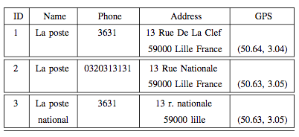
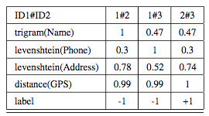
Data Description
Data Sources : https://archive.ics.uci.edu/ml/datasets/Nomao
Number of Attributes:118
Number of observations: 34465
Raw data: Names of places, address, GPS, website, phone, fax, etc
Raw Material
Final data format

Slide 5
Model Selection
Error Rate (n_{learn} = 0.5n)

Slide 6
Model Selection
Error Rate (n_{learn} = 0.9n)

Slide 7
Model Selection
10-Fold CV Curves (n_{learn} = 0.5n)
Hyper Parameter (min)
Lasso: 2.198272e-05
Ridge: 0.0001528139
Hyper Parameter (1se)
Lasso: 0.000761111
Ridge: 0.0005973713

Slide 8
Model Selection
10-Fold CV Curves (n_{learn} = 0.9n)
Hyper Parameter (min)
Lasso: 7.147075e-05
Ridge: 1e-05
Hyper Parameter (1se)
Lasso: 0.0003446919
Ridge: 0.0001525115

Slide 9
Model Selection
CV & Fit Time
N_learn=0.5n
Model | Cross Validate Time | Fit Time | Test Error Rate
Lasso Logistic | 26.532 | 2.624 | 0.059408
Ridge Logistic | 16.641 | 4.66 | 0.056328
SVM | 1125.808 | 3.067 | 0.057168
Random Forest Tree | NA | 11.069 | 0.053592
N_learn=0.9n
Model | Cross Validate Time | Fit Time | Test Error Rate
Lasso Logistic | 43.297 | 4.482 | 0.054600
Ridge Logistic | 25.984 | 7.084 | 0.057040
SVM | 4212.567 | 13.389 | 0.051560
Random Forest Tree | NA | 21.413 | 0.045920

Slide 10
Feature Importance & Conclusion
Coefficients Comparison

Slide 11
Feature Importance & Conclusion
Feature Importance

Slide 12
Thanks

